Slide 1
Notes:
Why can I not update the date???

Slide 2

1. Registration & Agenda
1. Registration & Agenda
2. Welcome & Apologies
  2.1 Membership - new members
  2.2 Quorum to Constitute a Meeting
  2.3 Proxies
3. Adoption of Minutes from Previous AGM
4. Chairperson’s Key Items
5. Operations
    5.1 Security
    5.2 Environment
    5.3 Infrastructure
6. Finance:
    6.1 Adoption of the Audited Financials
    6.2 Adoption of Implementation Plan
    6.3 Adoption of the Business Plan
    6.4 Approval of Budget
7. Election of Board Members
8. Questions & Answers
9. Statutory Approvals - Voting
10. Close
11. Town-Hall for Other Issues
Chairperson: Kiki Loubser

Slide 3
2.1 Welcome & Apologies
As a statutory legal entity, we have to apply the regulations, and do.
Therefore we must stick to our mandate. We cannot grant favours ^{or make exceptions.}
^{New} ^{members: have} to apply for membership, 14 days in advance of the AGM
Proxies have had to have been received 24 hours before the meeting
Members in arrears with municipal accounts more than 60 days are not allowed to vote, unless you have made arrangements with the city.
Director nomination forms had to have been received – (3 days) 72 hours before meeting
Only registered members may vote – membership not transferable and not automatic by virtue of ownership
Owners with multiple properties have a vote per property, but must apply for membership in respect of each property
The votes and proxies are managed independently by LUMI
Letter of Authorization required for properties owned via a legal entity – directors’ or trustees’ resolution required to be submitted
3

Slide 4
2.2 Membership, Quorum, and Proxies
Membership
  316 properties- all pay SRA levy whether members or not
  ^{2021:} ²⁰⁹ eligible members - 66.1% of properties represented
  2020: 168 eligible members - 53.2% of properties represented
  ^{Listed on website}
Quorum
  20% of the members or 42 members
  Owners with multiple properties only counted once for purposes of quorum; but they do have one vote per property
Proxies
  ^{41 valid proxies received}
Apologies
  ^{To be Announced}
4

Slide 5
3. Adoption of Minutes from Previous AGM
  Propose – who?
  Seconder – who?
  Vote – at End
5

Slide 6

4.1 Chairperson’s Key Items
Key issues:
  Security
  Environment
  Infrastructure
2 Bodies serve Community Interests- this meeting deals with SRA
“Party houses” – dealt with outside of this meeting (afterwards)
6

Slide 7
4.2 Chairperson’s Key Items
 | SRA
1 | Registered property owners are eligible to be members - not automatic, must apply
2 | Membership is voluntary
3 | Contributions to levies is NOT voluntary, levied by City of Cape Town, based on property value
4 | Areas of Operation/Scope:
 | 4.1 Public open areas, and environment
 | 4.2 Security of suburb - public areas
 | 4.3 Environment
 | 4.4 Clearing services - top up, beaches, paths etc.
 | 4.5 Future: marine environment
7

Slide 8
4.3 Chairperson’s Key Items
SRA Board Members: they serve the community as volunteers, and do not receive payment for their service.
All actions taken are governed by the following governance mechanisms:
  Oversight by the City
  Are a registered NPC company – and therefore regulated in terms of the Companies Act;
  Registered as part of CIPC, as directors of the company.
  Conflicts of interest are recorded and avoided
Property Valuations: levies are based on property valuations and can be objected to by owners
Finally a huge thank you to the board members for their dedication and tireless efforts
8
Notes:
Acknowledgements:
Last year, per request from the Chairman, we wish to recognise and acknowledge the efforts of Greg Wright
Environment: incredible leadership role played by Samantha Lupini re beach clean-up
Thanks to the Committee, City of Cape Town and Llandudno community

Slide 9
5.1 Security
Wesley Corbett, Carel De Ridder, Andrew Jakins
Presented by Wes Corbett

Slide 10
5.1a Security – Existing System
Budget – 88% of total LSRA Budget (66% for Responders & 33% for Cameras)
Cameras on Perimeter – Thermal & InfraRed with special Analytics for Alerts & LPR
Cameras on Streets – Donated; Optical and InfraRed; some with ColorVu (color at night)
Monitoring Off-Site – OmniVision; who calls responders when needed; system checks
Monitoring On-Site – Phone Apps for Responders (PPA, ADT, & CCP)
Monitoring by LSEC – Telegram Alerts of Live zoom-able/replaying .gif triggers 24/7
Public Space Response – Dedicated PPA 24/7 (dog at night)
Home-Alarm Response – Both dedicated PPA and ADT vehicle 24/7
Communications –WhatsApp, Radios, shared LSEC Email; and Emergency Contact List
Car Guards – supported via CCP program for Bibs and Registration for Consistency
Coordination – between PPA & ADT & LSLC; and WATCHCON managed by CCP
Cooperation – CPF (Community Policing Forum) for SAPS & Law Enforcement
10

Slide 11
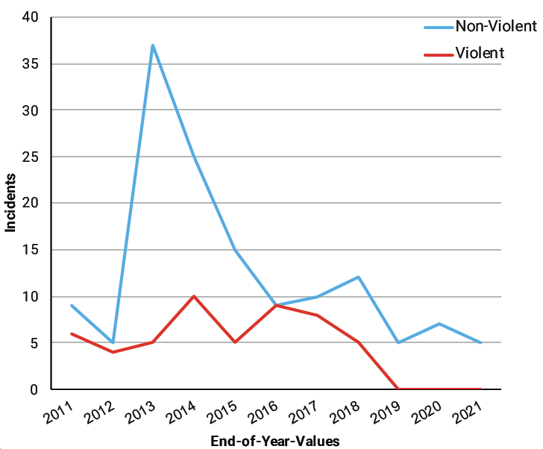
5.1b Security – Statistics (01DEC20 to 30NOV21)
No violent crimes – but need to remain vigilant with Home Alarms & Locked Doors (testing by you....or thieves)
Five Incidents - theft (Bikes, Skateboard, Camera, & Phone at Beach) most from gang of young kids during Argus & Halloween; and once at night via Sandy Bay (most identified after investigation)
11

Slide 12
5.1c Security - Improvements Over Last Year
Budget - Existing Maintained which limits increases to approved inflation plus realistic premium
UPS – Upgrade with Lithium for all 22 sites for 59 cameras for R 253,000 for Stage 4
Fiber – switched away from Telkom & enhanced 3G Back-Up and tech support
S.I. - Faster Notification of Camera Alerts direct to Responders via upgraded software
Telegram - Improved performance checks of camera alert auditing by LSEC
ColorVu & AcuSense - Cameras upgraded in several key locations with private donations
Mikrotik - Cameras added via new technology to securely integrate private networks
59 Total Now - Cameras added via large private donations pledged utilizing the above
UHF Ch. 3 - Radio Coverage Area improved thru large private donation to infrastructure
Radio Network - Administration by HBNW improving to allow greater participation
LSLC - Beach crimes being relayed by Lifesavers via donated radios
CPF - Advocated for: Taxi Regulation, Plate & Reg Checking, & Vendor Permitting
12
Notes:
Project team - thanked for incredible service to Llandudno

Slide 13
5.1d Security – Challenges Ahead & Proposals
Camera Replacement – By 30 JUN 2022 need R1M with current lease financing costs
Camera Replacement – By 30 JUN 2026 need R1.2M to start saving now to buy with cash
Civil / Parking Violations – need reference numbers & photos; handed over to Infrastructure
Land-Invasion – threat requires immediate and compliant action (2 in 2021); need skill
Communications – sharing info between multiple responders & monitors; need consolidation
13

Slide 14
5.1e Security – Internal Discussions On-Going
Neighborhood Watch – remote patrolling by volunteers; during events etc…
Drones – costs, training, and legality are challenging, plus practical sustainability
Seismic Sensor Test Program – under review with industry players
Booms for Beach Parking – separate committee reviewing complicated facilitation
Clamping and/or Towing Parking Violations – law changes being advocated
Hut Infrastructure Improvement – proposals being prepared
Law Enforcement “Rent-a-Cops” – too expensive & no guarantees of attendance
Party-House Targeting – supporting ongoing efforts for legal enforcement
Street View Cameras – Limited to Donations; to continue
Fences on Public Perimeter – not permitted, reviewing alternatives for long-term
Apostle Battery Preservation and/or Land-Use – being closely monitored
Kerzner & Bakoven – Land Invasion threats being addressed cooperatively
14

Slide 15
5.2 Environment – Environmental Report 2021
Presented by Jonathan Crowther with support from Mark Greig
With thanks to Huck Endersby for all that he did for Llandudno

Slide 16
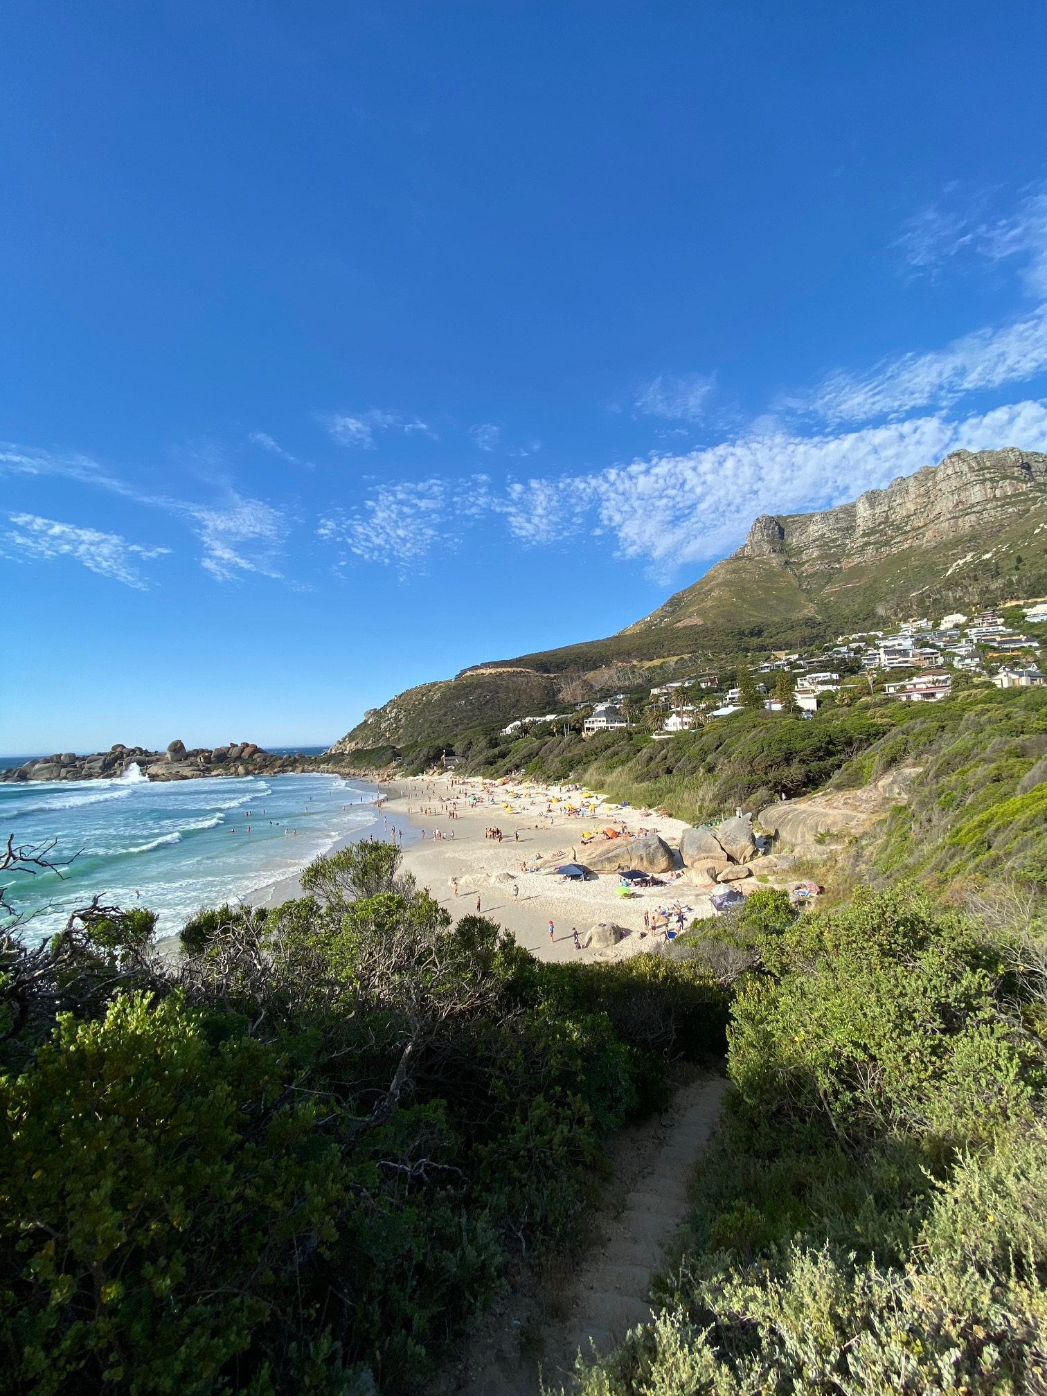
Llandudno SRA
Environmental Report 2021
  Construction: Retaining walls, Irrigation and Signs
  Fire Risks
  Vegetation cutting and removal
  Litter and Bins
16
Notes:
3 x topics.

Slide 17

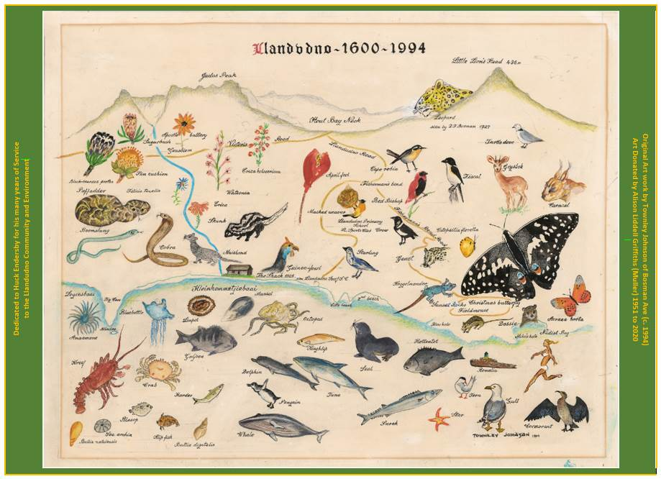
Construction: Retaining walls, irrigation and signs
  Small retaining wall built behind lifesaving club
  Repair to log retaining wall on Llandudno Road opposite post box
  Repair to stairs going down to beach
  Irrigation of new “forest” area
  Removal of repetitive excess City signage
  Erection of new signs at beach
17
Notes:
Paths. Jojo tank to irrigate new trees. Portable tank for Weaver’s bakkie.

Slide 18
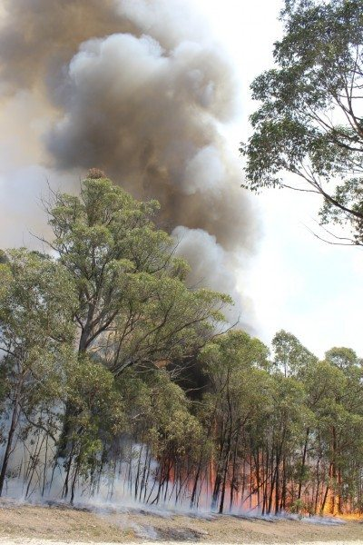

COMBATTING FIRE RISKS
SRA liaises with SANParks and Kerzner Estate to ensure firebreaks are timeously and properly maintained annually.
Firebreaks on north and south side of Llands cleared in mid- December by SANParks
Weaver team maintains alien vegetation control along northern firebreaks between annual clearing
TIPS TO PROTECT YOURSELF AND YOUR HOME:
  Minimising fire risk each homeowner’s responsibility
  Keep all access roads and hydrants free for fire department
  Garden hoses will be minimally effective
  Focus on brush removal and firebreaks
18
Notes:
SRA, Firebreaks. Access roads. Gums to north, could get the wrong wind. Carel?

Slide 19
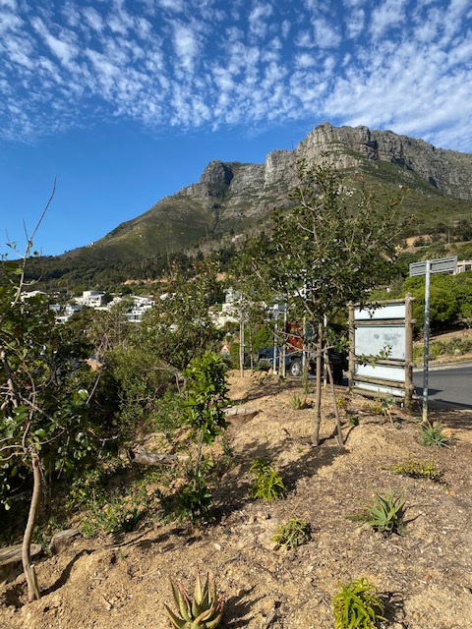
  Vegetation cutting and removal
  Ongoing removal of Port Jackson and Rooikrans by Weaver’s
  Cutting back of bush along all access paths to main beach, coastal paths and along the road
  Trimming trees along main access roads
  Slowly working along other roads to remove weeds and bushes leaning into the road
  Clearing stormwater drains
  General cutting and weeding of public open spaces
19
Notes:
Clearing various invasives in gully stream and re-planting. Funded privately and through plant donation valued at R 100,000 from City.

Slide 20


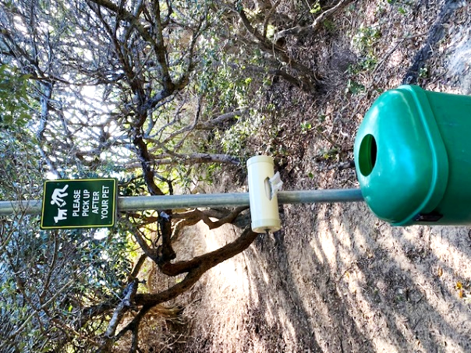
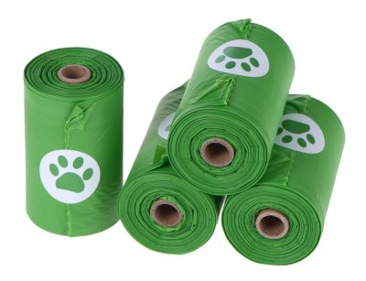
Litter & Bins
Installation of green litter bins, signage and bag dispensers for dog droppings.
20

Slide 21
5.3 Infrastructure
Presented by Andrew McNulty

Slide 22
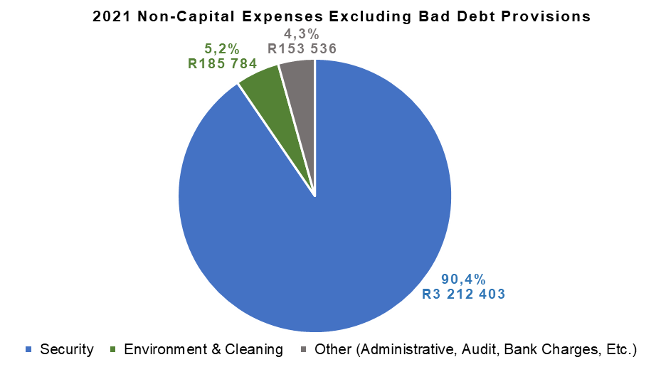
5.3a Background
LSRA has no mandate / budget for Infrastructure
Rely on CoCT services, responsiveness, etc.
Four (Five) Infrastructural Areas:
  1. Road Maintenance & Signage
      Parking / Congestion
  2. Electricity
  3. Sewerage
  4. Water
22

Slide 23
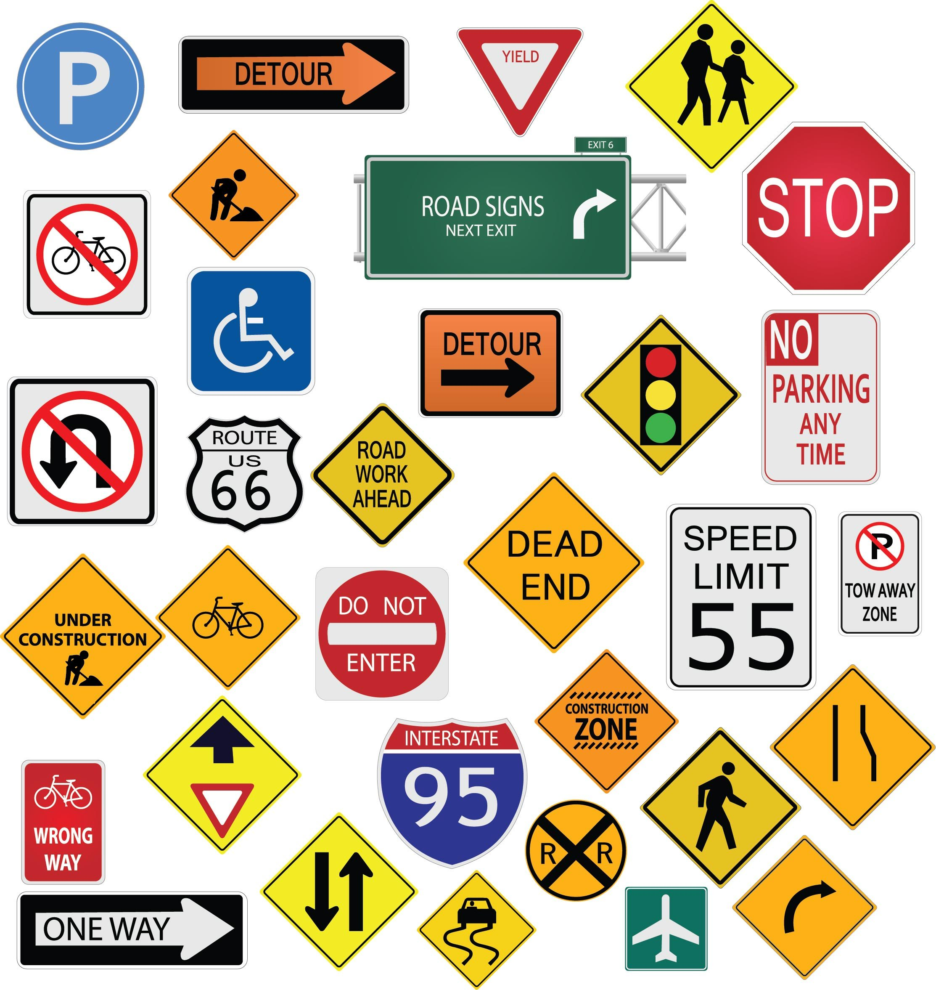

5.3b Road Maintenance, Signage & Traffic
Road Maintenance & Signage
Built up relationships & contacts with the CoCT
Thirteen (notified) items addressed over 20 months (one large project)
  Potholes, painted road lines, unblocking storm water channels, new signs
  Slow execution during lockdown periods
Traffic Enforcement
Motivation to City Chief of Traffic for proactive traffic enforcement
Effective 06 December 2021 – at least one officer deployed to Llandudno/Hout Bay
23

Slide 24
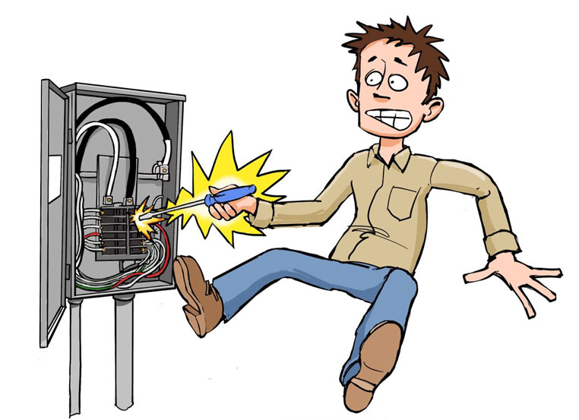

5.3c Electricity
Power failure problems during 2021
Two separate incidents impacting multiple households
Linked to building developments (?)
Addressed by CoCT as a project (priority)
In general, responsiveness from CoCT is good.
24

Slide 25


5.3d Sewerage
Increasing number of sewerage leaks
21 (notified) faults over the past 20 months
CoCT fixes most faults promptly
LSRA Infrastructure sub-committee
  Project to work with the City to provide preventative maintenance
  Budget, Practical implementation with the City
25

Slide 26



5.3e Water
Increasing number of water faults (burst pipes)
36 (notified) faults since January 2021
CoCT fixes most faults promptly
The Community Water Crisis (14 – 21 Nov 2021 and 2 – 4 Dec 2021)
  Councillor: Public Open Day (08 December 2021)
26

Slide 27
6. Finance
Presented by Ian Scott

Slide 28

6.1 Annual Financials
Clean Audit Report
Income Tax Exempt
Donations received for tree removal & specific cameras
Retained income for the year of R1 085 967
Cash reserves of R981 579 representing:
Two month levy reserve and uncommitted Cash
28

Slide 29
6.2 & 6.3a Implementation & Business Plan
The Financial Year runs from 01 July - 30 June
Additional rates are determined every 5 years through a detailed process:
  5-year Business & Implementation Plan
  5-year Budget
Budgeting is done on a Cash Flow basis with Income = Expenses + Capex
The approval process is rigorous:
  Debated & Approved by the LSRA Board
  Submitted for Modeling & Approval by the City of Cape Town
  Tabled for Approval at the LSRA AGM
The current 5-year Budget & Plans for 2020 to 2024 approved at 2018 AGM
29

Slide 30
6.3b Increase in SRA Levy on Rates Bill
8.5% for inflation plus realistic margin effective from 1st July 2022 as per last years approved plan
91 Rand / month increase for average value ERF
The actual amount charged to each property is determined by the relative value of each property to the total municipal value of the whole of Llandudno
    e.g: If your property is valued at 1% of the total value of Llandudno, your additional rates bill will be 1% of the budget of the LSRA
Irrespective of what changes there are in the municipal values, the owners are charged and the LSRA receives the Budgeted Income only
The municipal revaluations every 3 years does not impact the budget:
  An overall higher valuation does not automatically translate to a higher budget
  An overall change in municipal valuations only determines the proportionate amount charged to each property
30

Slide 31
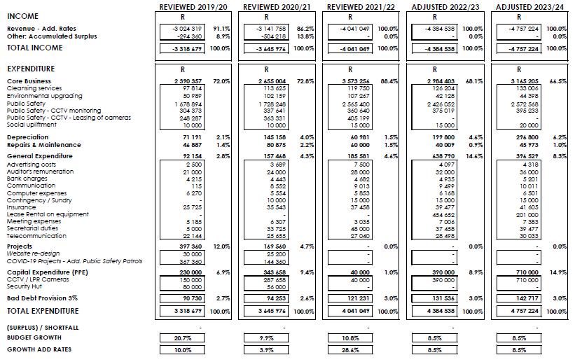
6.4a 5-Year Budget 2020 -2024
31

Slide 32
6.4b 5-Year Budget 2020 -2024 Summary
32

Slide 33
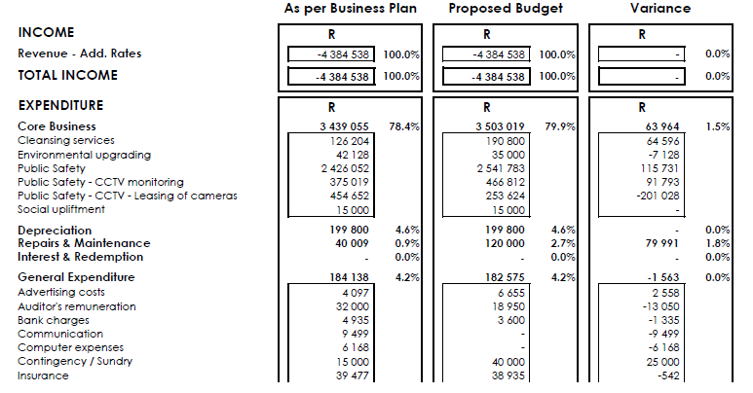
6.4c Proposed Budget 2022/23 - Page 1
33

Slide 34
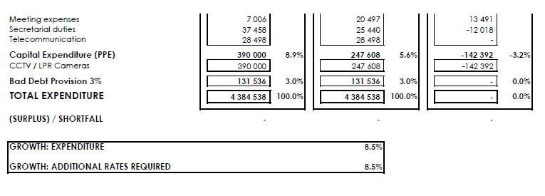
6.4d Proposed Budget 2022/23 – Page 2
34

Slide 35
7. Election of the Board
Kiki Loubser

Slide 36
7.1 Board Currently
No. | Surname | First Name | Term | No. of Terms | First Appointed to AGM | Re-appointed to AGM | Rotation 2019 | Rotation 2020 | Rotation 2021 | Rotation 2022 | Rotation 2023
1 | Pearce | Alistair | 3 years | 2 | Resigned |  |  | X
2 | Endersby | Huck | 3 years | 2 | Resigned** |  |  | X
3 | Bond-Smith nee Loubser | Kiki | 3 years | 2 | 2014* | 2017 | X |  | x |  | X
4 | MacKenzie | Margie | 3 years | 2 | Resigned**
5 | Aufrichtig | Jody | 3 years | 1 | 2016 | - | X |  |  | X
6 | Corbett | Wesley | 3 years | 1 | 2017 | - |  | X |  |  | X
7 | Greig | Mark | 3 years | 1 | 2018 | - |  |  | X
8 | McNulty | Andrew | 3 years | 1 | 2018 | - |  |  | X
9 | Crowther | Jonathan | 3 years | 1 | 2020
Co-Opted Members
No. | Surname | First Name | Term | No. of Terms | First Appointed | Appointed to Board |  | Status as a co-opted member
9 | Scott | Ian | 12 months | 1 | 2021 | 2021 |  | Resigned
10 | Jakins | Andrew | 12 months | 1 | 2021 | 2021 |  | Resigned
11 | Curtis | Rob | 0 months | 1 | 2021 | 2021 |  | Resigned
Legend:
* | Appointed at Special General Meeting on formation of Company
** | Resignation w.e.f. end of AGM
36

Slide 37
7.2 Board Proposed for Election
 | Name | Current Portfolio | Status | Action
1 | Kiki Loubser | Chair | Resign by rotation | Stand for re-appointment
2 | Wesley Corbett | Security | Current
3 | Jody Aufrichtig | Projects | Current
4 | Ian Scott | Treasurer | Co-opted | Stand for appointment
5 | Andrew Jakins | Security/infrastructure | Co-opted | Stand for appointment
6 | Jonathan Crowther | Environment/beach/social development | Current
7 | Rob Curtis | Communication | Co-opted | Stand for appointment
8 | Andrew McNulty | City Liaison/finance/ infrastructure | Resign by rotation | Stand for re-appointment
9 | Mark Greig | Legal/Environment | Resign by rotation | Stand for re-appointment
37

Slide 38

8. Q & A
38

Slide 39
9. Statutory Approvals
Kiki Loubser

Slide 40

9. Statutory Approvals - Voting
Ratification of Board Decision ref. Electronic Meeting
Approval of Minutes of the Previous AGM
Adoption of the Audited Financials 2020-2021
Adoption of Base Case Budget FY 2022/2023
Adoption of Implementation Plan 2022-23
Appointment of Auditors
Confirmation of Company Secretary
Election of Board Members (see next slides)
40

Slide 41
10. Meeting Closed
41

Slide 42
11a. Town Hall for Other Issues – “Party Houses”
City of Cape Town Municipal Planning By-Law July 2015 as amended 2019 (CoCT MBY15):
1. SR1 - All properties are zoned single residential where the dominant use of the property is for a single family; but allowing for bed & breakfast so-long-as the proprietor lives on the property (CoCT MBY15 Ch. 5/21),
Bed & Breakfast - is maximum of 3 rooms & 6 transient guests (CoCT MBY15 Ch. 5/24); being a temporary guest for no more than 30-days continuous (CoCT MBY15 Ch. 5/Def pp91); with minimum off-street parking of 1 bay per dwelling plus 1 additional bay per guest room (CoCT MBY15 Ch. 15/138),
Long-Term rentals are by default >30-days & require plan approval & rates for 2nd or 3rd dwelling with kitchen,
Noise Nuisance – is anything audible in the public space / street (WC Prov Gaz 6469 Sect 3(b)).
Anyone can report evidence of such violations to the City of Cape Town at their website. However, the LCA can independently pursue any violators that routinely violate the above AND any of the following internal guidelines:
a. Minimum of 2-day consecutive rentals,
b. Owner must be resident in Llandudno for rentals less than 7-days,
c. Maximum of 2 overnight guests per approved bedroom.
The proposed guidelines in RED give clear & enforceable higher-thresholds that the LCA will use in determining when it is necessary to utilize collective LCA resources to solicit action from Law Enforcement and the Courts.
(if you cross the RED Line...we will take-action)
42

Slide 43
11b. Security – Challenges Ahead & Proposals
Huts at Entrance & Sandy Bay – LCA reports poor performance by ADT; specifically:
    Ineffective adherence to Community S.O.P.; allowing vagrants to pass
    Skill of duty personnel is insufficient for challenging times (ref. Radios)
    Abandoned Sandy Bay Hut without notice; poorly maintained beams
Home-Alarm Response – LCA requesting residents to contract PPA so we get to:
  130 Subscribers to take-over Sandy Bay Hut
  180 Subscribers to take-over Entrance Hut
43

Slide 44

The End
44

