Slide 1
Notes:
Why can I not update the date???

Slide 2

1. Registration & Agenda
Chairperson: Kiki Loubser
1. Registration & Agenda
2. Welcome & Apologies
3. Membership & Quorum
4. Proxies
5. Adoption of Minutes from Previous AGM
6. Chairperson’s Key Items
7. Operations
    7.1 Security
    7.2 Environment
    7.3 Infrastructure
8. Finance:
    Adoption of the Audited Financials
    Adoption of Implementation Plan
    Adoption of the Business Plan
    Approval of Budget
9. Election of Board Members
10. Special Resolution
11. Questions and general
12. Statutory Approvals - Voting
13. Close

Slide 3
2. Welcome & Apologies
As a statutory legal entity, we have to apply the regulations, and do.
Therefore we must stick to our mandate. We cannot grant favours ^{or make exceptions.}
^{New} ^{members: have} to apply for membership, 7 days in advance of the AGM
Proxies have had to have been received 24 hours before the meeting
Members in arrears with municipal accounts more than 60 days are not allowed to vote, unless you have made arrangements with the city.
Director nomination forms had to have been received – (3 days) 72 hours before meeting
Only registered members may vote – membership not transferable and not automatic by virtue of ownership
Owners with multiple properties have a vote per property, but must apply for membership in respect of each property
The votes and proxies are managed independently by LUMI
Letter of Authorization required for properties owned via a legal entity – directors’ or trustees’ resolution required to be submitted
3

Slide 4
3 & 4. Membership, Quorum & Proxies
Membership
  316 properties- all pay SRA levy whether members or not
  2023: 192 members – 60.0% of properties represented
  ^{(with 180 eligible to vote)}
  2022: 210 members – 66.5% of properties represented
  ^{2021:} ²¹⁰ members - 66.5% of properties represented
  2020: 168 members - 53.2% of properties represented
  List on Website (with only ERF and Address)
Quorum
  20% of eligible members or 36 members
  Owners with multiple properties only counted once for purposes of quorum; but they do have one vote per property
Proxies
  ^{2 with Chair}
Apologies
  ^{Board Member Andrew McNulty}
4

Slide 5
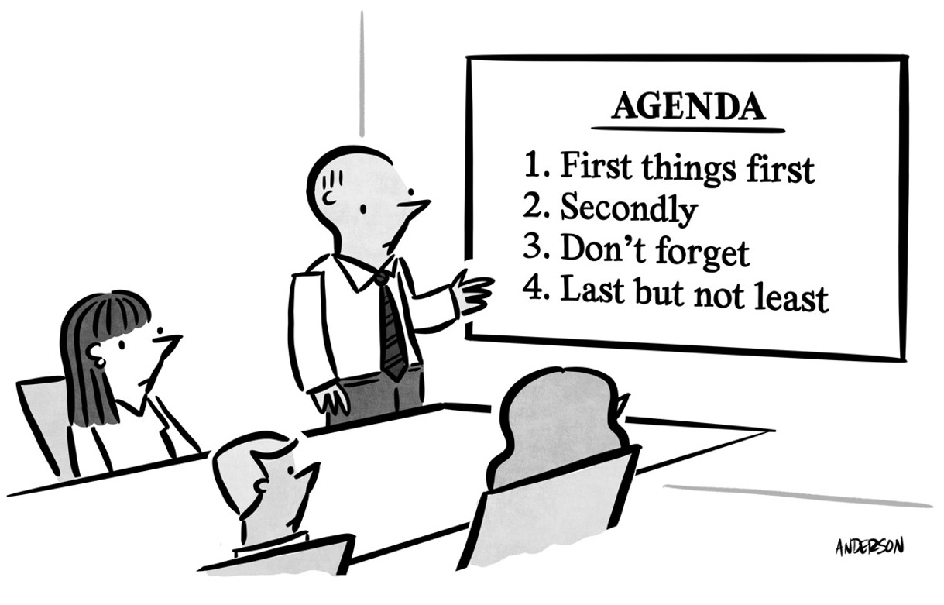
5. Adoption of Minutes from Previous AGM
  Propose – who?
  Seconder – who?
  Vote – at End
5

Slide 6

6. Chairperson’s Key Items
Ci
City of Cape Town
LSRA – Llandudno Special
Ratings
Area
Key issues:
  Security
  Environment
  Infrastructure
  Improved signage regarding beach safety
LCA – Llandudno Civic Association
LBAC
LBAC = Llandudno Building and Advisory Committee
LSEC = Llandudno Security Committee
6

Slide 7
6. Chairperson’s Key Items
 | SRA | LCA
1 | Registered property owners are eligible to be members - not automatic, must apply | Any resident may become a member
2 | Membership is voluntary | Membership is voluntary
3 | Contributions to levies is NOT voluntary, levied by City of Cape Town, based on property value | Contributions are set and Administered by the LCA and are voluntary
4 | Areas of Operation/Scope: | Areas of Operation/Scope:
 | 4.1 Public open areas, and environment | Property Owners' built environment - LBAC
 | 4.2 Security of suburb - public areas | Building regulations and enforcement
 | 4.3 Environment | Vision re densification of the suburb
 | 4.4 Clearing services - top up, beaches, paths etc. | NIMBY = not in my back yard
 | 4.5 Future: marine environment | Need for residents to know the regulations and participate actively to try to prevent further issues Rates affordability & Valuations objections
7

Slide 8
6. Chairperson’s Key Items
SRA Board Members: they serve the community as volunteers, and do not receive payment for their service.
All actions taken are governed by the following governance mechanisms:
  Oversight by the City
  Is a registered NPC company – and therefore regulated in terms of the Companies Act;
  Registered as part of CIPC, as directors of the company.
  Conflicts of interest are recorded and avoided
Property Valuations: levies are based on property valuations and can be objected to by owners
Finally a huge thank you to the board members for their dedication and tireless efforts
8
Notes:
Acknowledgements:
Last year, per request from the Chairman, we wish to recognise and acknowledge the efforts of Greg Wright
Environment: incredible leadership role played by Samantha Lupini re beach clean-up
Thanks to the Committee, City of Cape Town and Llandudno community

Slide 9
7.1 Security
Wesley Corbett, Carel de Ridder, Andrew Jakins
Presented by Wes Corbett

Slide 10
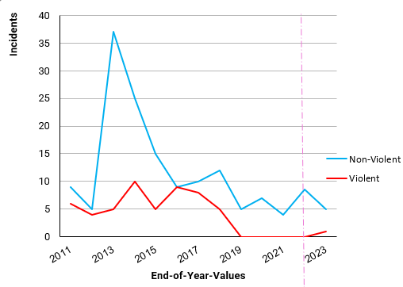
7.1a Crime Statistics (1 December 2022 – 20 November 2023)
Crime remains very low, with Beach Crime being the main challenge. Extensive camera network that is monitored and linked direct to the patrollers is a key factor in the success. Cameras ready for 6-year lifecycle replacement; with sufficient funds saved Budget inclusive of CPI increases to save for 2029 lifecycle replacement to give a further 5-years (to 2034) New entrance hut a 2024 priority and needs significant donations
10
…but we need to maintain & test Home Alarms & lock our gates / doors

Slide 11
7.1b Crime Incidents (1 December 2022 – 20 November 2023)
Dec 22 | Main Beach - bags stolen from beachgoers
Dec 22 | Main Beach - bags stolen from beachgoers
Jan 23 | Main Beach - bags stolen from beachgoers
Oct 23 | Phone stolen during Halloween 'trick or treating'. Phone recovered the next day
Oct 23 | Man mugged by four men armed with knives near entrance to Llandudno. Made off with phone and money. Only reported days later
Oct 23 | Main Beach - bags stolen from beachgoers but suspects caught in car park due to the actions of the car guards and PPA
11

Slide 12
7.1c Security – Details of Existing System
Cameras on Perimeter w/UPS – Thermal; (2 of 3 main already replaced); with Analytics & LPR
Cameras on Streets w/UPS – Optical; upgrading to new gen ColorVu (color view at night; more clear)
Monitoring Off-Site – OmniVision; verifies triggers, calls responders to act; integration maintenance
Monitoring On-Site – Phone Apps for Responders (vehicles); alerts audited by LSEC
Public Space Car – Dedicated LSRA funded PPA 24/7 (with dog at night); coordinated by WATCHCON
Home-Alarm Car – Dedicated private funded vehicles PPA & ADT 24/7; both with WATCHCON Radio
Hut at Entrance – 24/7 Indirectly privately funded (previously by ADT, now PPA); upgrading hut
Hut at Sandy Bay – 12/7 Indirectly privately funded (previously by ADT, now PPA); maintaining
Car Guards – Informal arrangement, but coordinated by community volunteer & CCP; disciplining
WATCHON Radio for HBNW Volunteers – Lifesavers, LSEC, CCP, and Hout Bay Neighborhood Watch
12

Slide 13
7.1d Security – Challenges & Plans
Speed – We have to catch criminals red-handed or in-chase; so QUICK notification is paramount
Privates Property – Residents must maintain & set alarms; connected to a control room
Equip Maint – Residents continue to support by allowing access to property , trimming, & adjustments
Camera Replacement Funds – Lifecycle upgrade ZAR 1.6M; now saving for same in 2029 (ZAR 2.8M)
Camera Selection – adjustments / trials finishing on 3 new models for consistent set-up & maintenance
Cameras Additional – 3 x Poles Proposed at: Victoria Road, 1st Three-Way, and Main Beach Parking
Coordination – addressing ongoing challenges between service providers via WATCHON
Car Guard Discipline – residents must report to WATCHON; who will follow-up with volunteer
Beach Parking - residents must get case number from CoCT website and post on group for stats
Party Houses – residents must get case number from CoCT website and post on group for stats
13

Slide 14
7.1e Security – Entrance Hut
Upgrade Desired – to make something we can be proud-of, long-lasting, and multi-purpose
LSRA Lease of Land - Initial approvals granted; community keeps control regardless of contractor
Building Approvals – Submitted & underway, going well; estimated to be done by 31MAR24
Construction – Hope to start immediately thereafter for 2-months; estimated done by 31MAY24
Usage - Also for: Landscaping contractor tools, radio chargers, and toilets
Cost - ZAR 800,000 estimated; with further competitive / more-detailed quotes pending
Fund with Donations - Several already committed; propose to add Appreciation Plaque
LSRA Funding for Huts – was not approved in prior budgets; and quick build would require financing with significant jump in Levies over 5-years (from 6.5% to 7.5%); therefore Donations are preferred
Contingency – if we fail to raise sufficient funds; we will have to utilize some of the saving for the 2029 camera replacement & 2024 expansion; to be reviewed and approved in a re-vote.
14

Slide 15
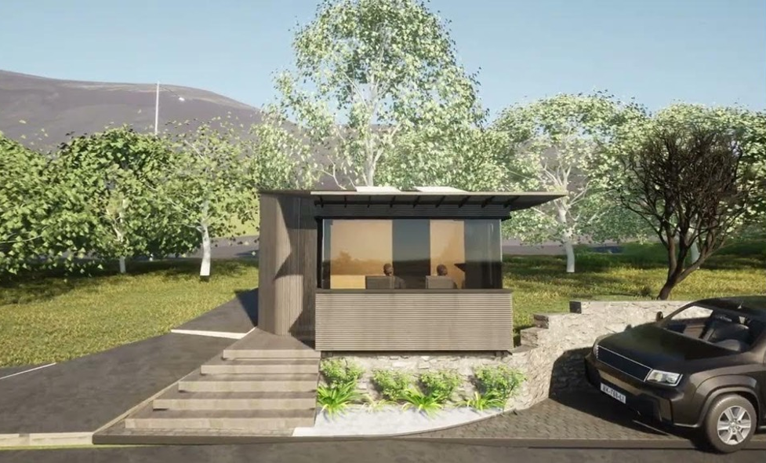
15

Slide 16
7.2 Environment – Environmental Report 2023
Presented by Jonathan Crowther

Slide 17
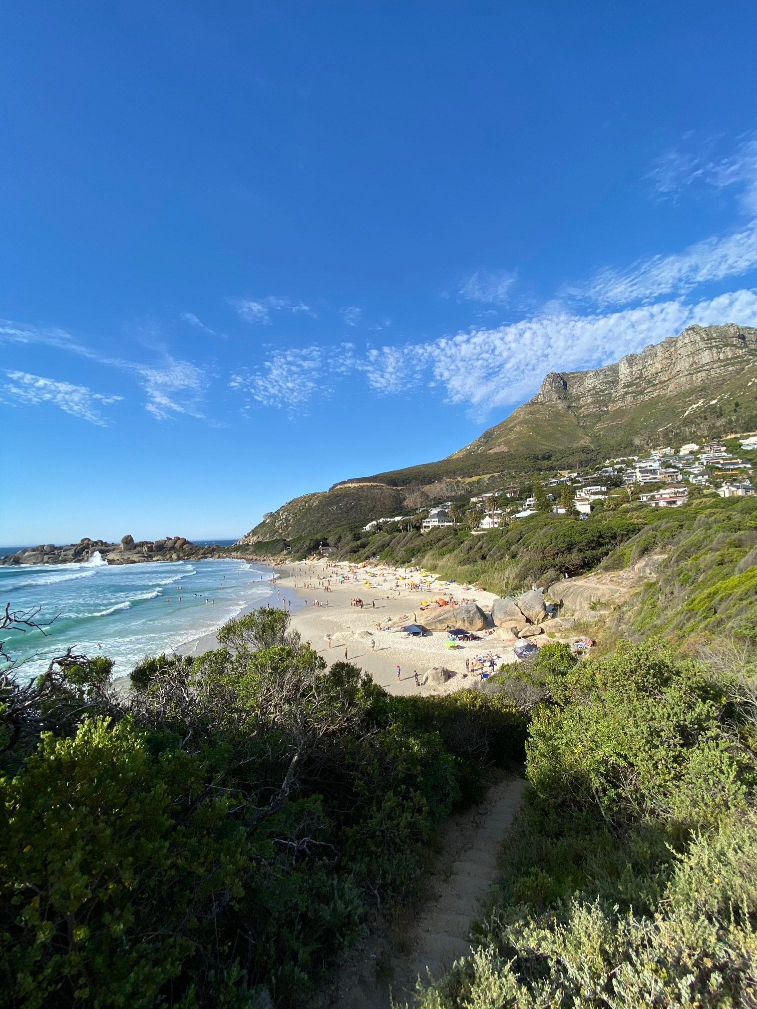
Llandudno SRA
Environmental Report 2023
  Fire Risk
  Vegetation Cutting & Removal
  Litter and Bins
17

Slide 18
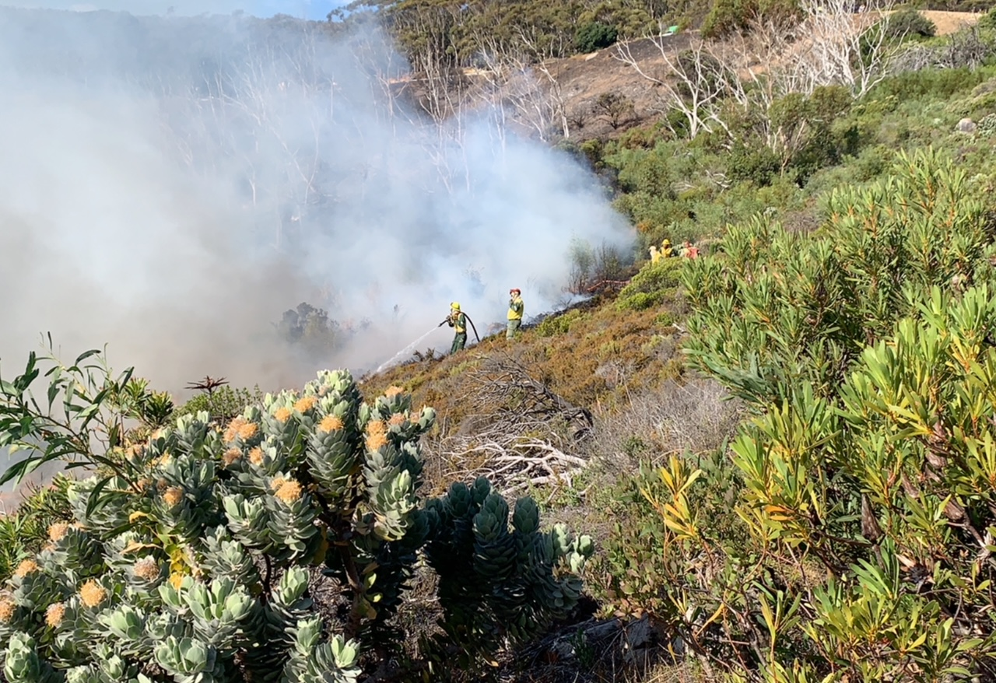
7.2a Fire
Major event - fire of Jan 2023 . Contained by rescue services. Stopped short of firebreak.
Follow-up controlled burn in Apr 2023. Rationale – remove further fire risk and rejuvenation of fynbos.
Subsequent removal of old dead gum trees and clearing of alien regrowth (Port Jackson by Sugarbird Trust and Llands Hackers group). Thanks to Catherine Moss for facilitating Sugarbird clearing.
Ongoing clearing of gums via Weaver’s team.
Will need continued clearing to hold back on alien sapling regrowth
SANParks cleared the firebreaks on north and south side of Llands in late Nov/Dec.
Weaver team maintains alien vegetation control along firebreaks between annual clearing.
18
Notes:
Acknowledgements:
Last year, per request from the Chairman, we wish to recognise and acknowledge the efforts of Greg Wright
Environment: incredible leadership role played by Samantha Lupini re beach clean-up
Thanks to the Committee, City of Cape Town and Llandudno community

Slide 19
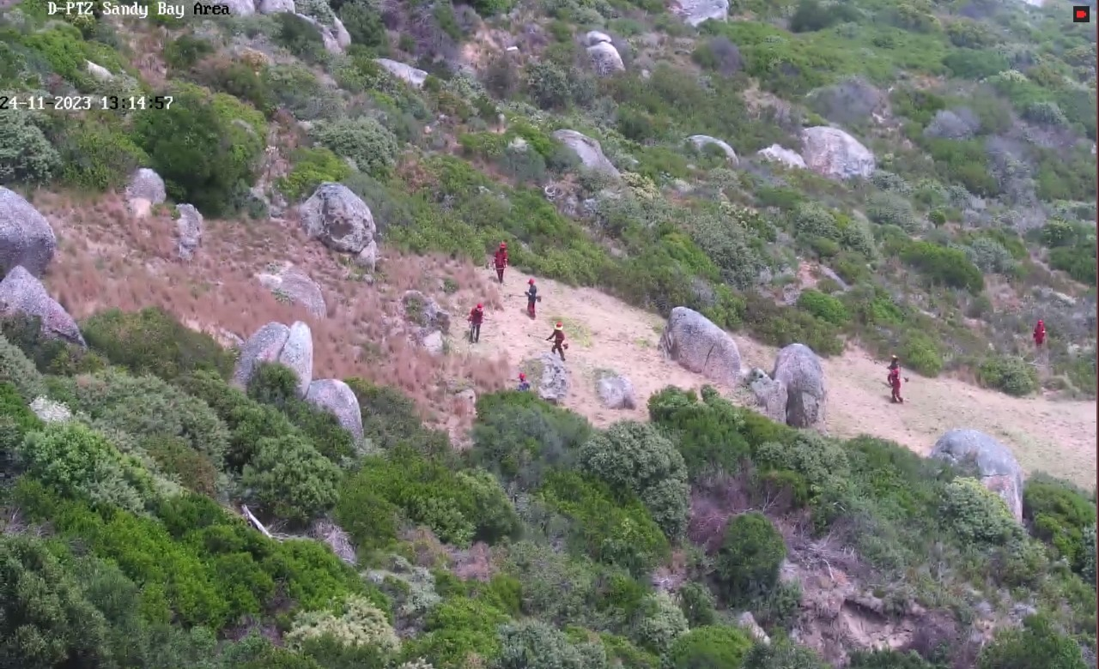
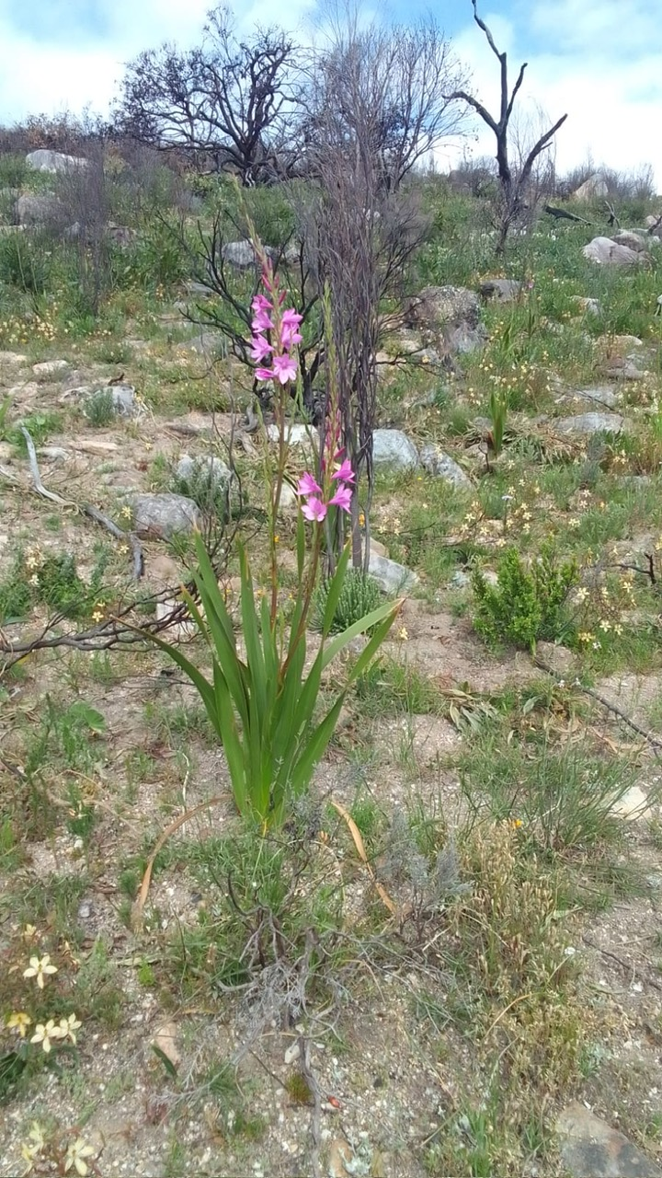
7.2a Fire
Tips to Protect Yourself & Your Home:
Minimising fire risk is each homeowner’s responsibility
SANParks fire officer re-iterated this point. First line of defense is ensure that your own property is free of aliens and that any vegetation in close proximity to house is cleared
Keep all access roads and hydrants free for fire department
Clear gutters ahead of the dry summer season
Garden hoses will be minimally effective
Watsonia - Post Fire
19
Notes:
Acknowledgements:
Last year, per request from the Chairman, we wish to recognise and acknowledge the efforts of Greg Wright
Environment: incredible leadership role played by Samantha Lupini re beach clean-up
Thanks to the Committee, City of Cape Town and Llandudno community

Slide 20
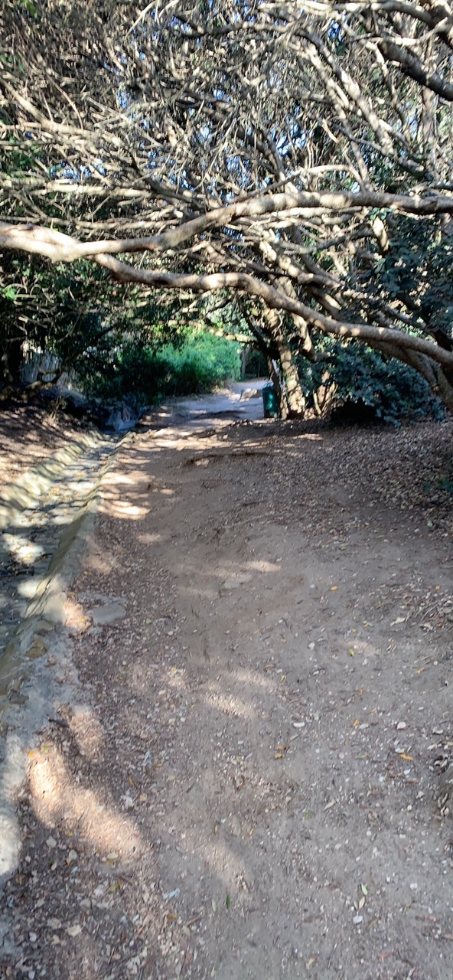
7.2b Vegetation Cutting & Removal
  Ongoing removal of Port Jackson and Rooikrans by Weaver’s across Llandudno
  Cutting back of bush along all access paths to main beach, coastal paths and along the road
  Substantial clearing of three sections of the Gully path.
  Trimming trees along main access roads
  Slowly working along other roads to remove weeds and bushes leaning into the road
  Clearing stormwater drains
  General cutting and weeding of public open spaces
  Dumping: A number of residents/their staff dump garden refuse in open spaces and the river courses. If this is observed, please report so that we can follow-up. The SRA does not attend to private dumping.
  NOTE: SRA does not cut trees planted by residents on the road verges. When trees and bushes are hanging over the road and obstructing traffic, please ask your service providers to remove such material.
20
Notes:
Acknowledgements:
Last year, per request from the Chairman, we wish to recognise and acknowledge the efforts of Greg Wright
Environment: incredible leadership role played by Samantha Lupini re beach clean-up
Thanks to the Committee, City of Cape Town and Llandudno community

Slide 21



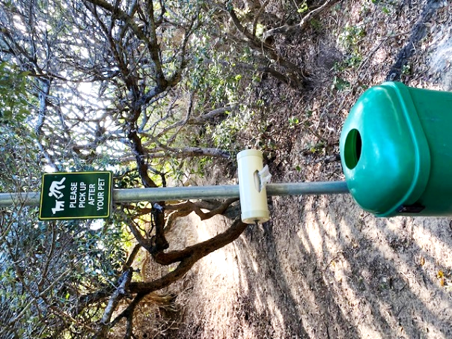
7.2c Litter & Bins
Please take responsibility for clearing up after your dogs. Fortunately, we have one or two fairies that do clear up almost daily (Morag and Sandy – thanks for picking up after others).
21

Slide 22
7.3 Infrastructure
Presented by Jonathan Crowther on behalf of Andrew McNulty

Slide 23
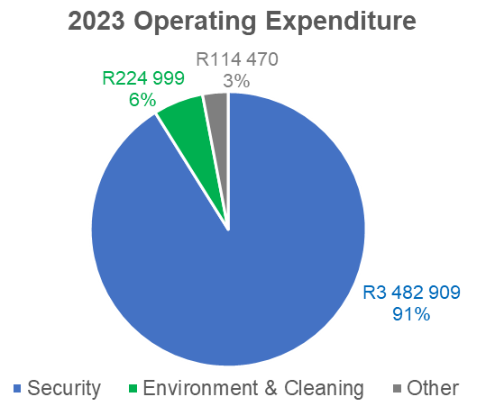
7.3a Background
No mandate / budget for Infrastructure in 5 year plan to 2024. Small budget 2024/25 onwards
Rely on CoCT services, responsiveness, etc.
Four (Five) Infrastructural Areas:
  1. Road Maintenance & Signage
      Parking / Congestion
  2. Electricity
  3. Sewerage
  4. Water
23

Slide 24
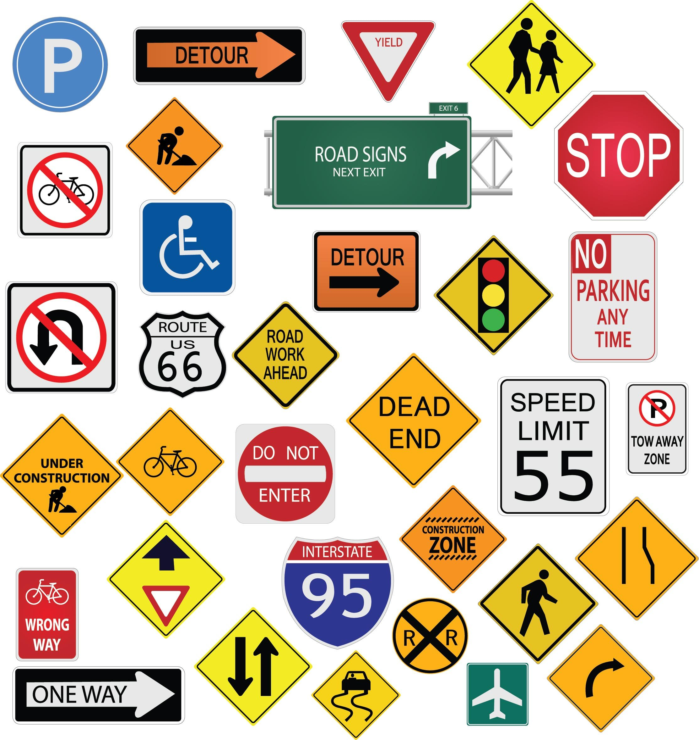

7.3b Road Maintenance, Signage & Traffic
Road Maintenance & Signage
Built up relationships & contacts with the CoCT
Twenty-five (notified) items addressed over 38 months (two large projects)
  Potholes, painted road lines, unblocking storm water channels, new signs
  Response time good except during hard lockdown
Traffic Enforcement
CoCT proactive traffic enforcement project was disappointing
Trying to understand other models e.g. Noordhoek
24

Slide 25
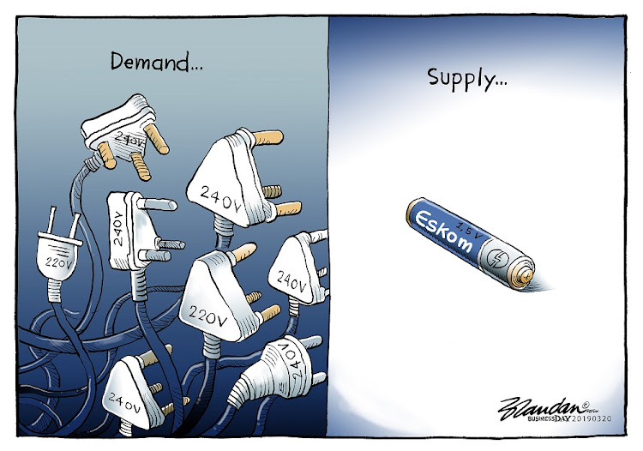
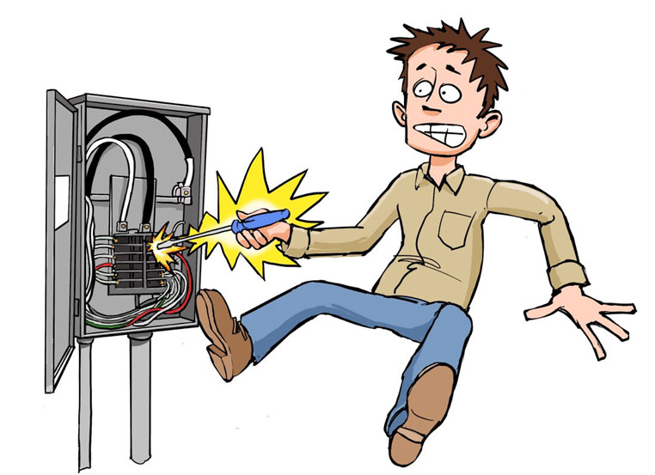

7.3c Electricity
Ignoring load shedding, less power failure problems during 2023 compared to 2022 and 2021
Most impacted – Leeukoppie Road and Steens Way
Addressed by CoCT as a project (priority)
In general, responsiveness from CoCT is good
25

Slide 26


7.3d Sewerage
Recurring problem of sewerage leaks
38 (notified) faults over the past 42 months
CoCT fixes most faults promptly
LSRA Infrastructure sub-committee
  Project to work with the City to provide preventative maintenance
  Budget, Practical implementation with the City
26

Slide 27
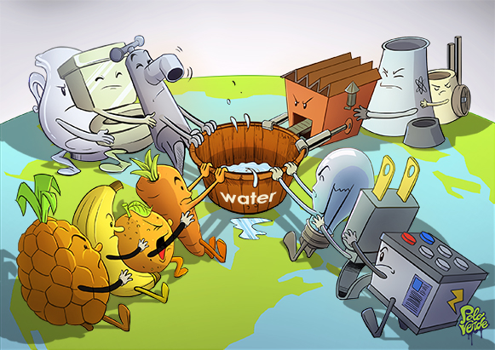


7.3e Water
Water faults (burst pipes) over past 12 months have been less than previous years
71 (notified) faults since January 2021
CoCT fixes most faults promptly
Wider Community Water Crisis - parts of Hout Bay more severely impacted
Plea: Report on the WhatsApp Group – tracking and ability to escalate with Counsellor
27

Slide 28
8. Finance
Presented by Ian Scott

Slide 29

8.1 Annual Financials
Clean Audit Report
Income Tax Exempt
Additions to Property Plant and Equipment of R 515 920 – paid cash
Net book value of Property Plant & Equipment to R 601 174 after the above additions
Surplus income for the year of R 759 353 and cumulative surplus of R2 338 459
Cash reserves of R 1 756 480 at year end (up from R 1 467 091 Last year)
Expenditure increased by only 2,1%
Income increased by 8,4% % as a result of budgeted income increase and release of retentions.
Interest received increased from R 31 300 in 2022 to R90 131.
Aim is to try build cash reserves further and to pay cash for new cameras
This will mean higher depreciation but no leasing costs once current lease ends (was a cost of ± R 240 000 p.a.)
Surplus going forward will be allocated to a capital expenditure reserve which will be used to replace equipment
29

Slide 30
8.2 Implementation & Business Plan
The Financial Year runs from 1 July to 30 June
Additional rates are determined every 5 years through a detailed process:
  5-year Business & Implementation Plan
  5-year Budget
Budgeting is done on a Cash Flow basis with Income = Expenses + Capex
The approval process is rigorous:
  Debated & Approved by the LSRA Board
  Submitted for Modelling & Approval by the City of Cape Town
  Tabled for Approval at the LSRA AGM
The current 5 year Budget & Plans 2020 – 2024 approved at 2018 AGM
New Budget is from 2025 to 2029 inclusive
30

Slide 31
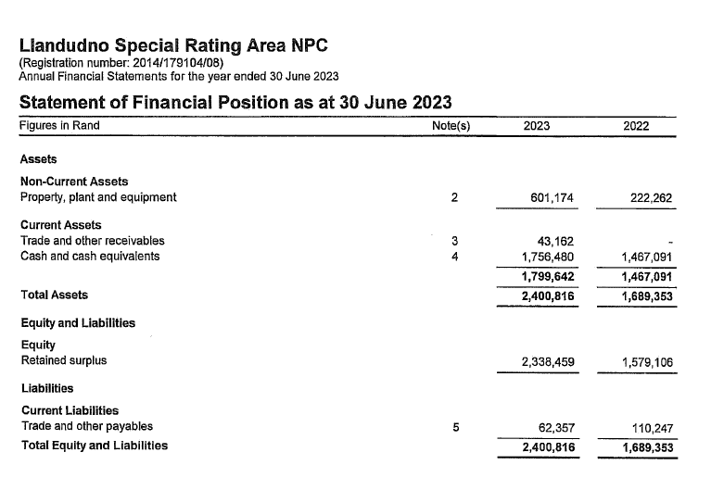
8.3 Statement of Financial Position as at 30 June 23

Slide 32
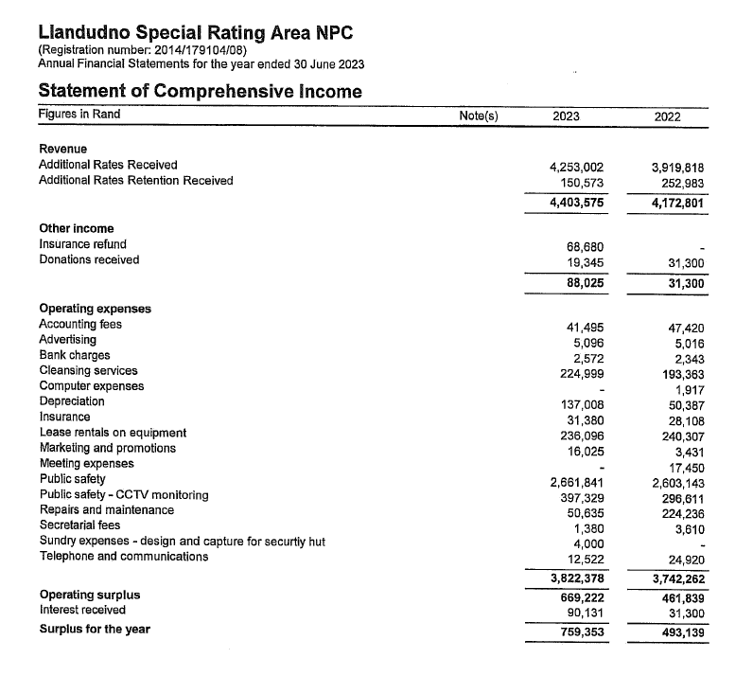
8.4 Statement of Comprehensive Income

Slide 33
8.5 Increase in SRA Levy on Rates Bill
6.5 % from 1st July 2024 (down from 8.5 % last year )
The actual amount charged to each property is determined by the relative value of each property to the total municipal value of the whole of Llandudno
    e.g: If your property is valued at 1% of the total value of Llandudno, your additional rates bill will be 1% of the budget of the LSRA
Irrespective of what changes in the municipal values, the owners are charged and the LSRA receives the Budgeted Income only
The municipal revaluations every 3 years does not impact this budget as we only recover agreed budget.
  An overall higher valuation does not automatically translate to a higher budget
  An overall change in municipal valuations only determines the proportionate amount charged to each property
33

Slide 34
8.6 5-Year Budget 2024 -2029
34

Slide 35
35

Slide 36

8.7 5-Year Budget 2024 -2029 Summary
Monies set aside for:
Environmental upgrading - R 100 000 p.a – Jonathan’s Portfolio
Urban Maintenance – R 100 000 p.a - Andrew’s Portfolio
Donations – R 20 000 budgeted but can be topped up with interest received on call account
Capital expenditure
This is our surplus and will be used to replace fixed assets:
2025 | R440
2026 | R 196 278
2027 | R 318 570
2028 | R 483 943
2029 | R 705 858
Total | R 1 705 089
36

Slide 37
9. Election of the Board
Kiki Loubser

Slide 38
9.1 Board Currently
No. | Surname | First Name | Term | Term | No. of Terms | First Appointed to AGM | Re-appointed to AGM | Rotation 2019 | Rotation 2020 | Rotation 2021 | Rotation 2022 | Rotation 2023
1 | Scott | Ian | 3 years | 3 years | 1 | 2021 |  |  | X
2 | Jakins | Andrew | 3 years | 3 years | 1 | 2021 |  |  | X
3 | Bond-Smith nee Loubser | Kiki | 3 years | 3 years | 4 | 2014* | 2017 | X |  | x |  | X
4 | Curtis | Rob | 3 years | 3 years | 1 | 2021
5 | Aufrichtig | Jody | 3 years | 3 years | 3 | 2016 | - | X |  |  | X
6 | Corbett | Wesley | 3 years | 3 years | 3 | 2017 | - |  | X |  | X | X
7 | Greig | Mark | 3 years | 3 years | 2 | 2018 | - |  |  | X |  | X
8 | McNulty | Andrew | 3 years | 3 years | 2 | 2018 | - |  |  | X
9 | Crowther | Jonathan | 3 years | 3 years | 1 | 2020 |  |  |  |  | X
Co-Opted Members
No. | Surname | First Name | Term |  | No. of Terms | First Appointed | Appointed to Board |  | Status as a co-opted member
9
10
11
Legend
* | Appointed at Special General Meeting on formation of Company
38

Slide 39
9.2 Board Proposed for Election
 | Name | Current Portfolio | Status | Action
1 | Kiki Loubser | Chair | Resign by rotation | Stand for reappointment
2 | Wesley Corbett | Security | Resign by rotation | Stand for reappointment
3 | Jody Aufrichtig | Projects | Current
4 | Ian Scott | Treasurer | Current
5 | Andrew Jakins | Security / Infrastructure | Current
6 | Jonathan Crowther | Environment / Beach / Social Development | Current
7 | Rob Curtis | Communication | Current
8 | Andrew McNulty | City Liaison / Finance / Infrastructure | Current
9 | Mark Greig | Legal / Environment | Resign by rotation | Stand for reappointment
39

Slide 40
10. Special Resolution – Amendment of MOI
Key changes
Expanded definitions
Requirements re income tax compliance enhanced
Membership: City of Cape Town has 1 vote
Membership terminates if 2 consecutive AGM’s not attended in person or by proxy
Members’ meeting can be held electronically
Quorum for members’ meeting reduced from 20% to 10%
Voting based on values ratio has increased to 1 vote per R10m of value with maximum of 10 votes
Directors must be members
Board meetings can be held electronically
40

Slide 41

10. Special Resolution Continued
Board meetings: members of community may attend by giving one week written notice
Dates of future board meetings must be published on website
Other changes relate to improved compliance and deadlines for submission of documents to the CoCT
41

Slide 42

11. Q & A
42

Slide 43
12. Statutory Approvals
Kiki Loubser

Slide 44

12. Statutory Approvals - Voting
Ratification of Board Decision ref. Electronic Meeting
Approval of Minutes of the Previous AGM
Adoption of the Audited Financials 2022-2023
Adoption of Base Case Budget FY 2024/2025
Adoption of Implementation Plan 2024-29
Appointment of Auditors
Confirmation of Company Secretary
Election of Board Members
Adoption of Special Resolution
44

Slide 45

13. Meeting Closed
45

